Slide 1

LuxeMod
Insights & Recommendations
GCOM 7140 — Customer Analytics
By: Enmanuel Baez, Tenzin Lodoe, Jad Shaheen, Luke Sherrill, and Kalsang Tseten
Notes:
Kalsang

Slide 2

Introduction
Company Overview:
Digital-first furniture retailer for young professionals and families
Focus on modern/modular designs for urban living spaces
Emphasis on pieces that serve multiple functions
Product lines cover main interior rooms (bedroom, bathroom, etc.)
Business Problems:
High cart abandonment rates
Challenges with customer retention
Inconsistent customer satisfaction scores
Need to optimize marketing spending
Objective:
Analyze customer behavior, product category trends, and digital engagement metrics to uncover key insights
Create predictive models to forecast cart abandonment rates and satisfaction scores
Form two recommendations to enhance customer experience, reduce cart abandonment, and maximize marketing efficiency
Notes:
Kalsang

Slide 3

Agenda
Dataset Overview
Data Cleaning
Exploratory Data Analysis
Predictive Modeling
Roadblocks & Resolutions
Strategic Recommendations
Q & A
Notes:
Kalsang

Slide 4
Dataset Overview
Variable
Description
Variable
Description
Satisfaction Score
Rating value for customer satisfaction
Age
Customer's age in years
Purchase Frequency
CLV
2-year projection in USD of a customer’s value
Number of purchases made to date by customer
Cart Abandonment
Customer proportion of shopping carts abandoned
Income
Customer annual household income in USD
Average Spending
Months Active
Number of months as an active customer
Customer’s average amount spent per order in USD
Notes:
Kalsang

Slide 5

Data Cleaning
Converted Features to Appropriate Data Types
Identifying Features with NA Values
Regression Model to Impute NAs
Logistic Regression to Impute NAs
Notes:
Jad

Slide 6
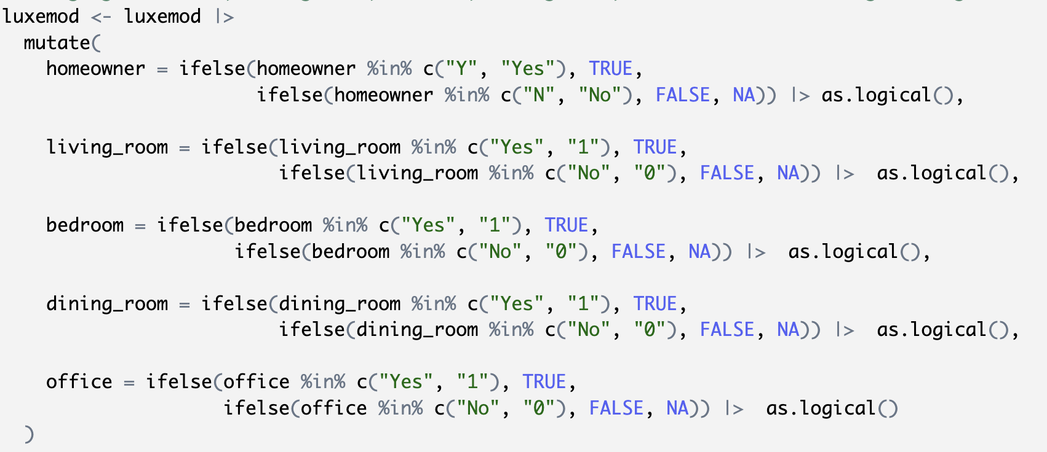
Converting Features to Appropriate Data Types
5 Features
Converted from Strings to Logicals
Notes:
Jad

Slide 7
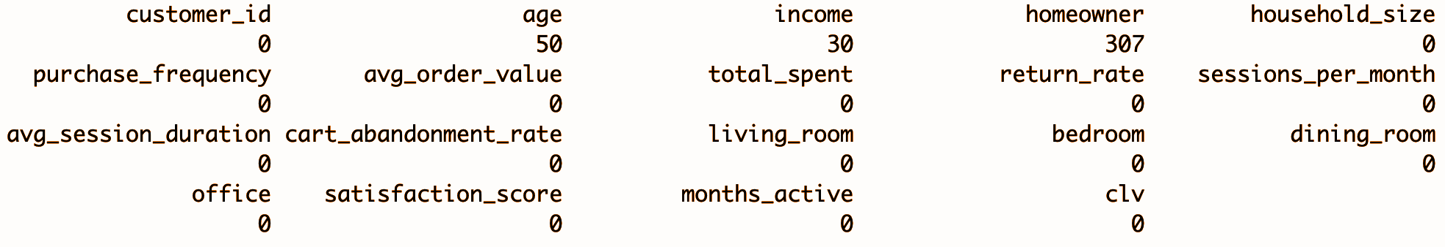
Identifying Features with NA Values
The table displays the number of missing values for each column, revealing patterns in data gaps.
The "Age", "Income", and "Homeowner" features have 50, 30, and 307 missing values respectively.
Notes:
Jad

Slide 8
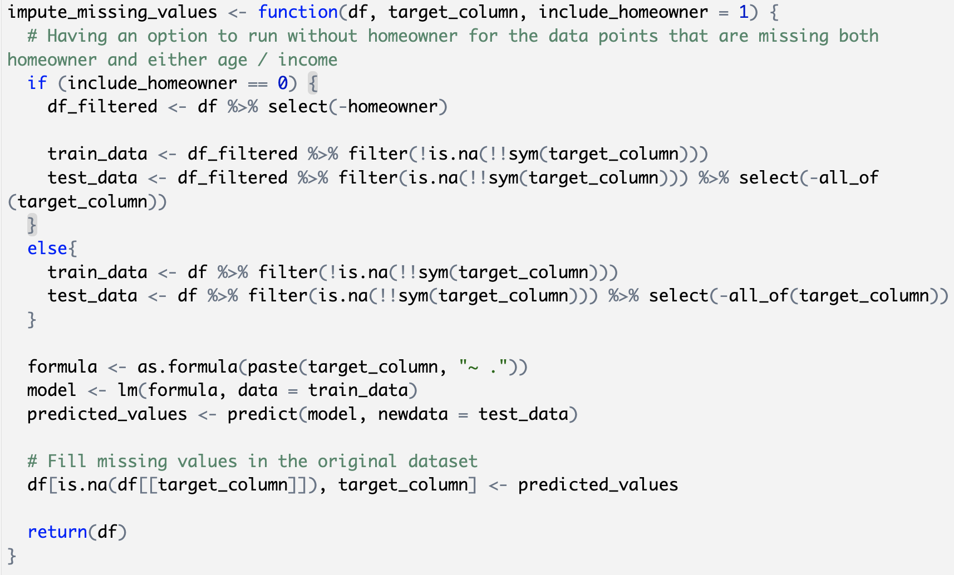
Regression Model to Impute NAs
impute_missing_values Function Created
Predict and impute Age and Income NA values.
Notes:
Jad

Slide 9
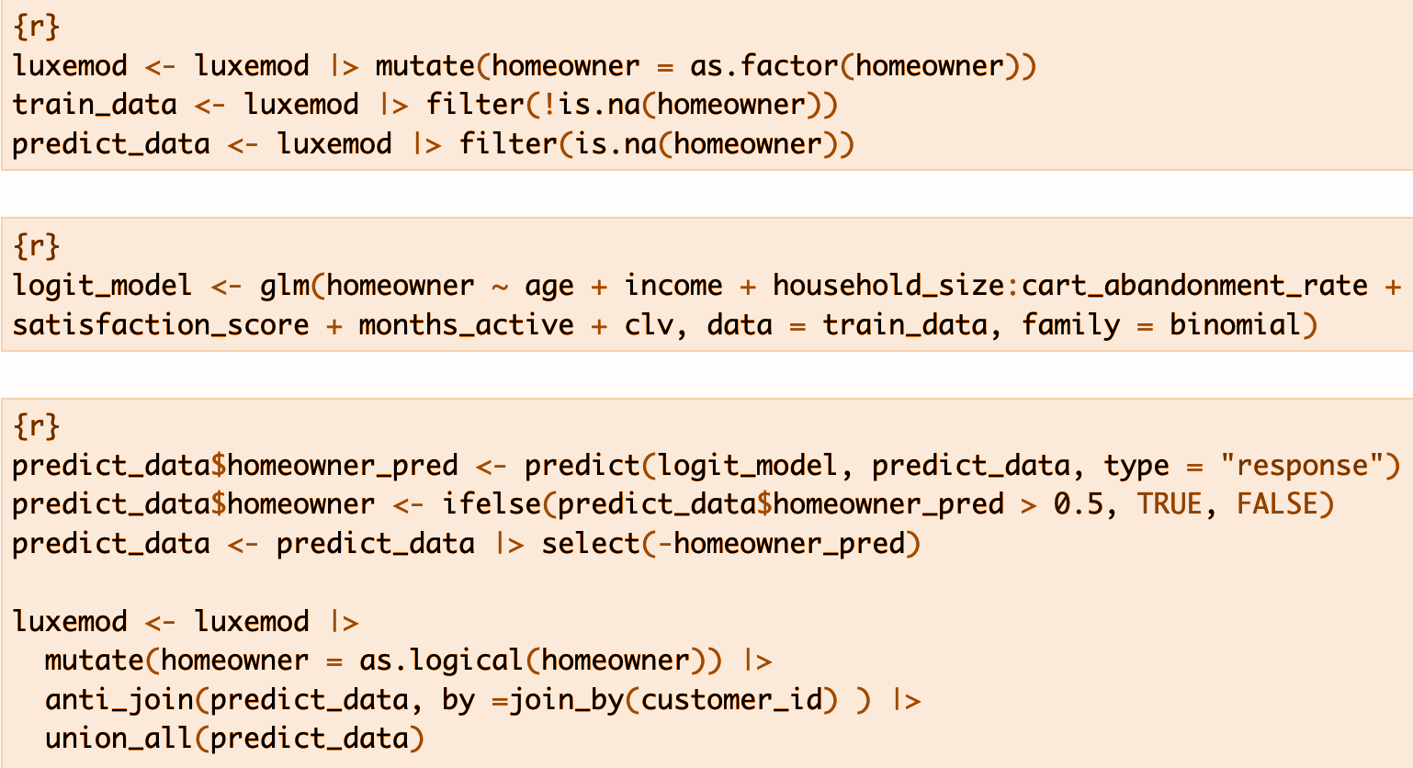
Logistic Regression to Impute NAs
A logistic regression model was trained to predict Homeowner status using all the features in the dataset.
Results
> 0.5 -> True
< 0.5 -> False
Notes:
Jad

Slide 10

Exploratory
Data Analysis (EDA)
Customer Segments
Products and Services
Customer Lifetime Value (CLV)
Cart Abandonment Rate
Notes:
Manny

Slide 11
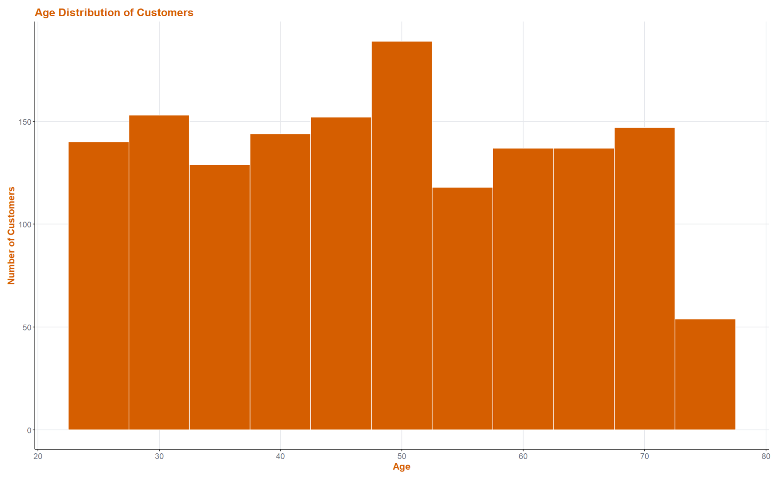
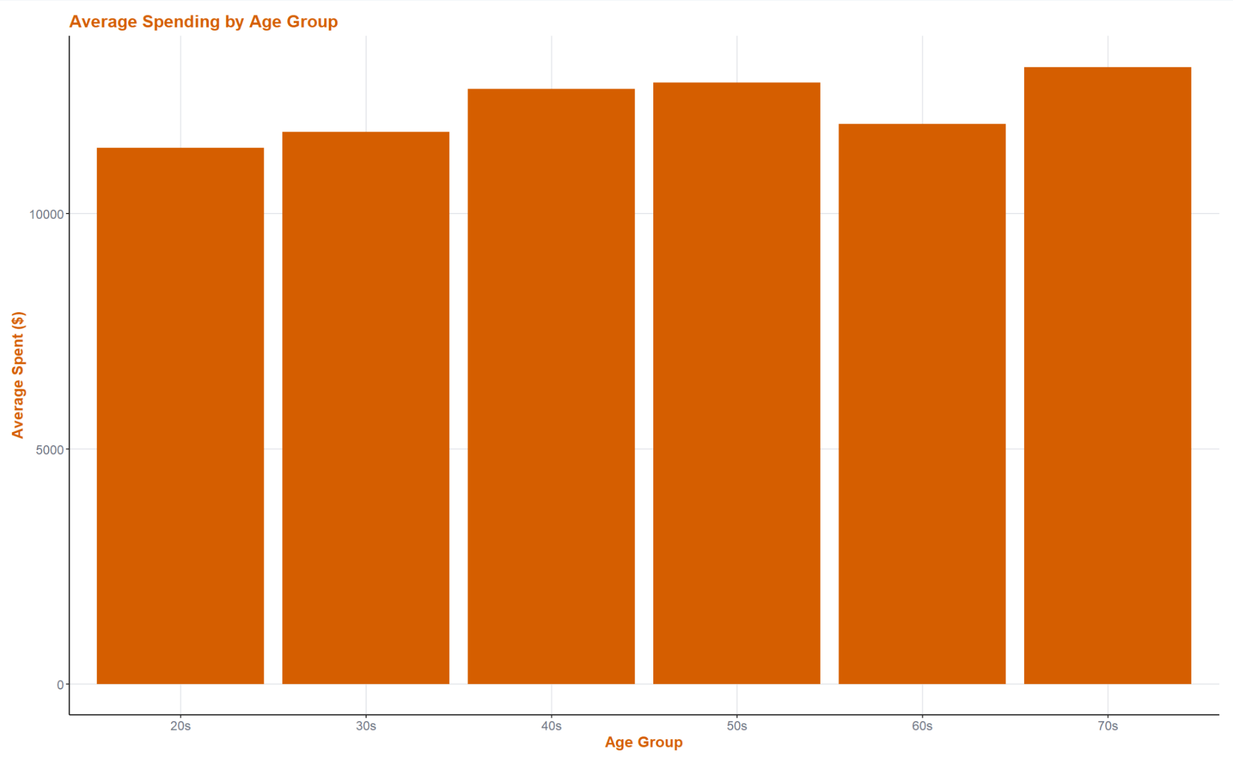
Customer Segments
Notes:
Manny
Age Distribution of Customers: The number of customers is roughly evenly distributed across all ages, with a small peak in the 50-year-old bracket.
Average Spending by Age: Age-groups roughly evenly distributed based on their average spending, again with a very small peak around 50s.

Slide 12
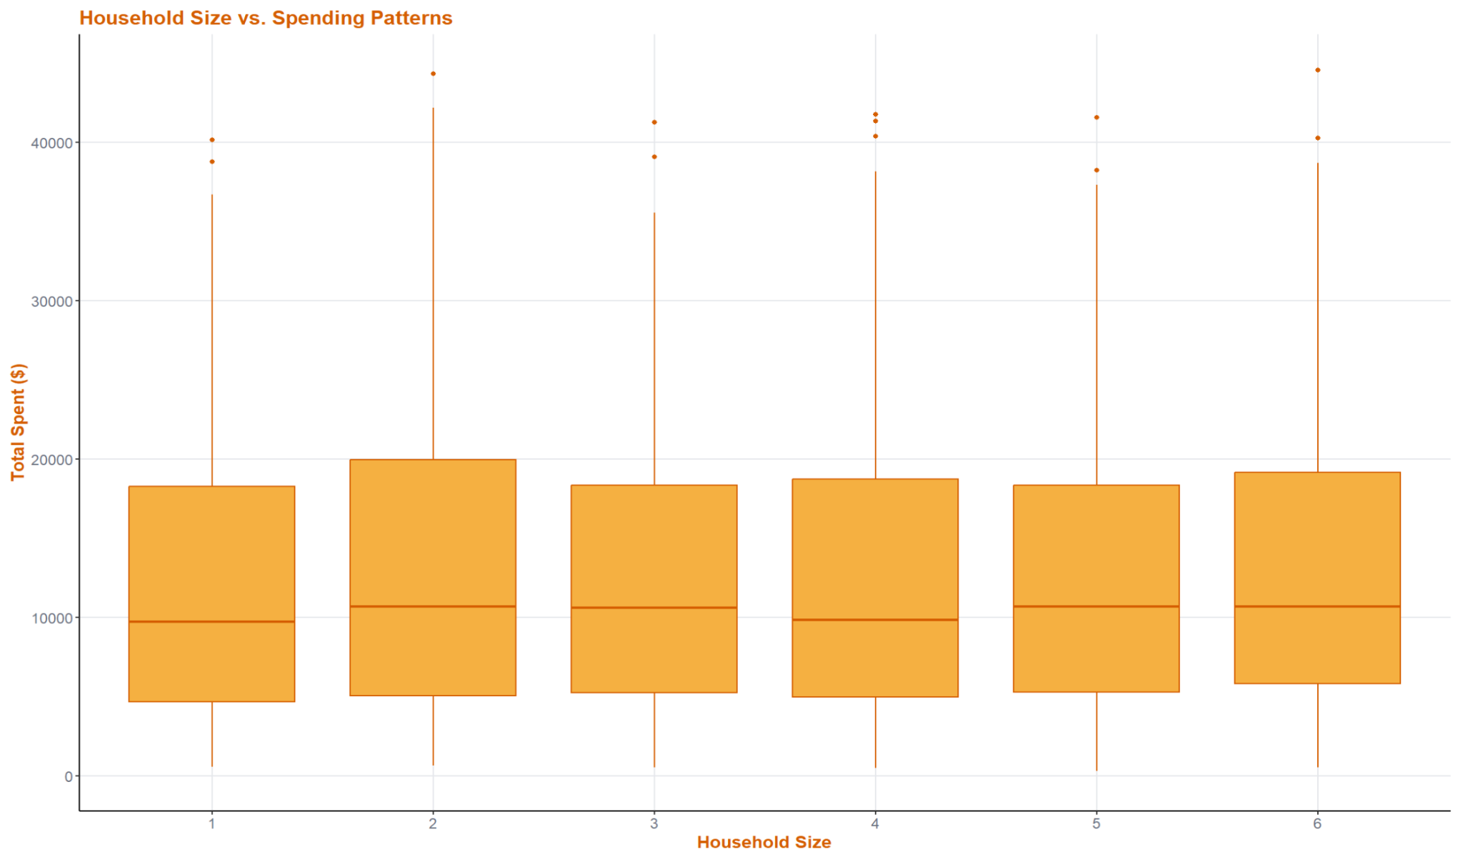
Customer Segments
Notes:
Manny
Household Size vs. Spending Patterns: Customer’s total amount spent based on their household is illustrated in this graph, with no clear pattern or trend. However, we do see that customers coming from households with 2 individuals have a slightly total amount spent. This could be attributed to LuxeMod’s business model of targeting young professionals and new families, who tend to be smaller in size.

Slide 13
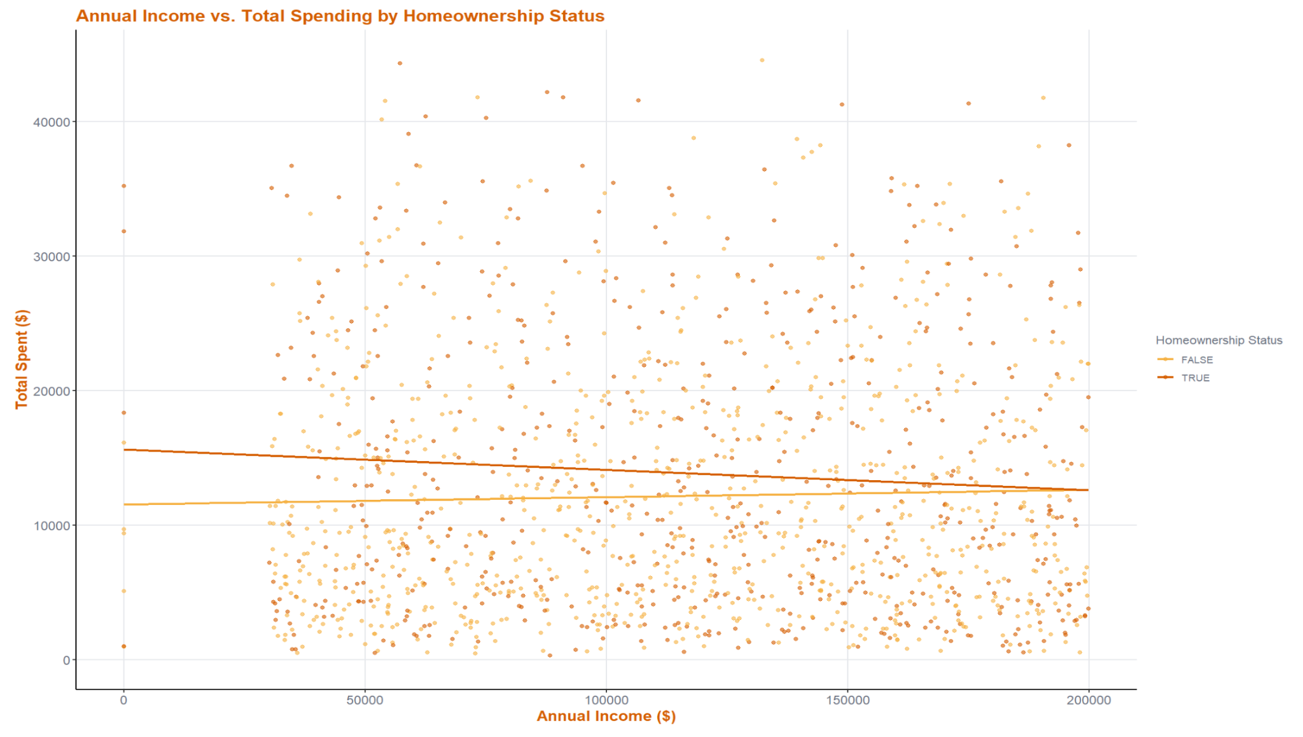
Customer Segments
Notes:
Manny
Annual Income vs. Total Spending by Homeownership Status: The graph indicates that for homeowners, as their income increases, their total amount spent in LuxeMod decreases, seen as the orange regression line. On the other hand, for non-homeowner, we see the opposite; as their annual income increases, so does their total spending in LuxeMod, as indicated by the yellow regression line. While these slopes may be weak, they do support the that LuxeMod’s business model of targeting young professionals and new families (non-homeowners) has been working, as they tend to spend more money on the company.

Slide 14
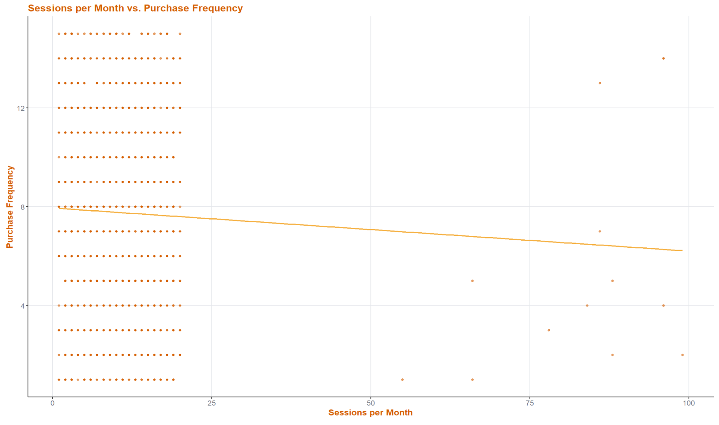
Products & Services
Notes:
Manny
Sessions per Month vs. Purchase Frequency: The amount of sessions (occasions in which the customer has visited the company’s website), appears to be evenly distributed across 0-25 sessions and 0-16 purchase frequency, with some outliers pulling the regression line down, giving it a negative slope. Because of the outliers and the evenly distributed data, not much information was able to gathered from this chart other than that there is a very weak association between sessions per month and purchase frequency, indicating that there are few customers who visited the website an extreme amount of times, yet reduced their purchase frequency. Maybe these individuals were unsure on whether they should make their next purchase and enjoyed doing some “window shopping,” thus always coming back to the website?

Slide 15
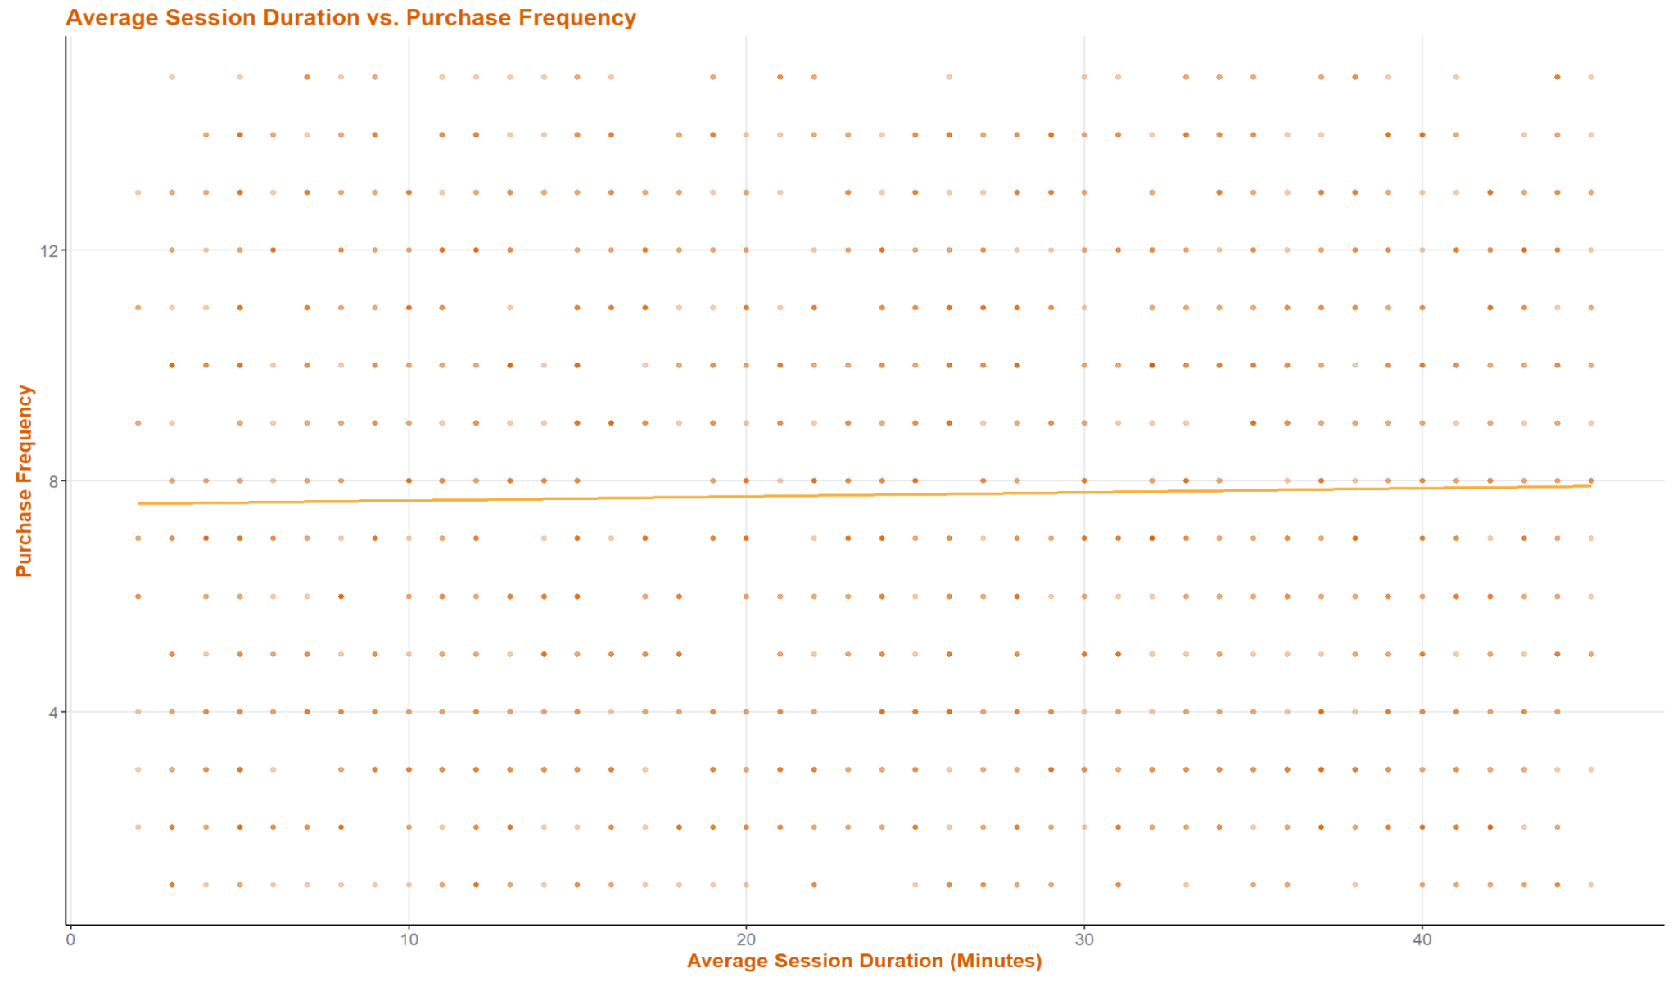
Products & Services
Notes:
Manny
Average Session Duration vs. Purchase Frequency: Based on the average amount of time a customer spends on the company’s website, we see this variable have a very weak positive relationship with purchase history. It is therefore safe say that average session duration is not a strong predictor of purchase frequency.

Slide 16
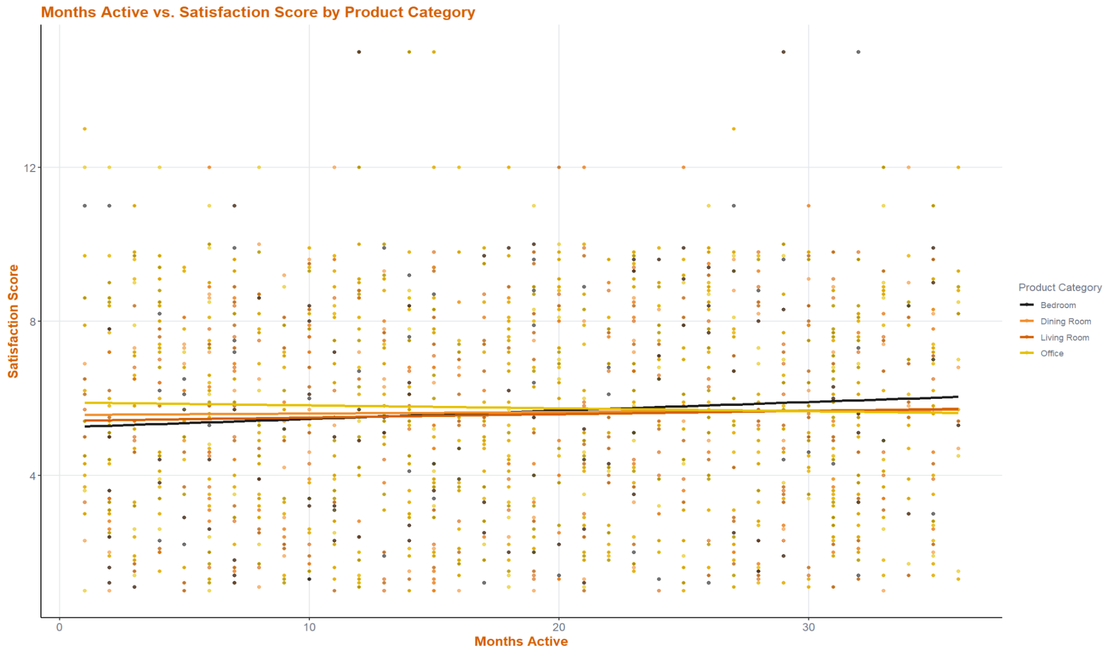
Products & Services
Notes:
Manny
Months Active vs. Satisfaction Score by Product Category: Based on the number of months a customer has had an active status, we see different slopes based on their purchased product category. A key insight that can be observed in this chart is that for customers with bedroom product purchases (black line), the regression line presents the strongest positive association between months active and satisfaction score. This suggests that LuxeMod is best at both retaining its customers and keeping them happy, particularly, with their bedroom products category! Customers are happy with the bedroom products they receive, and keep on coming for more.

Slide 17
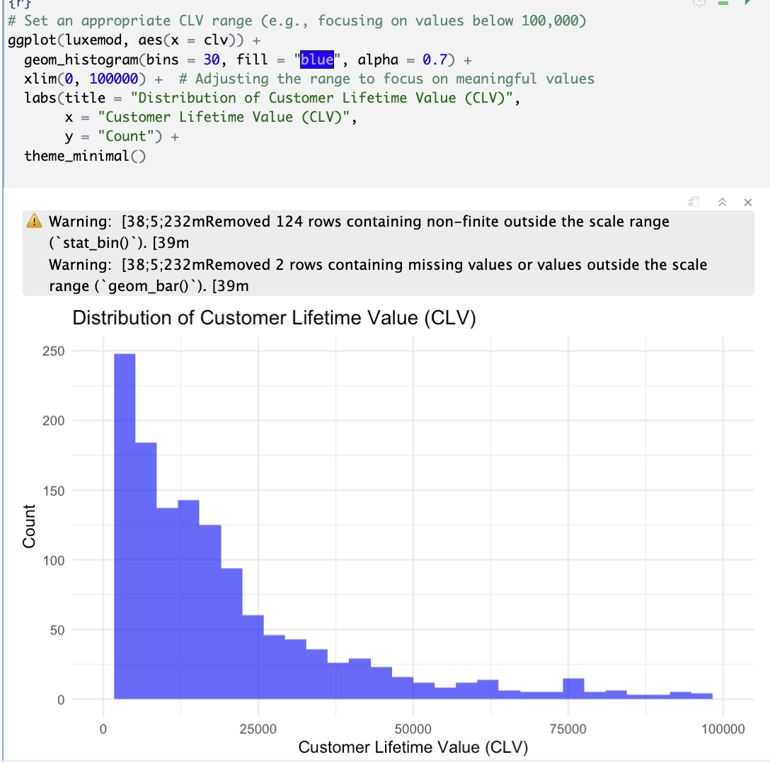
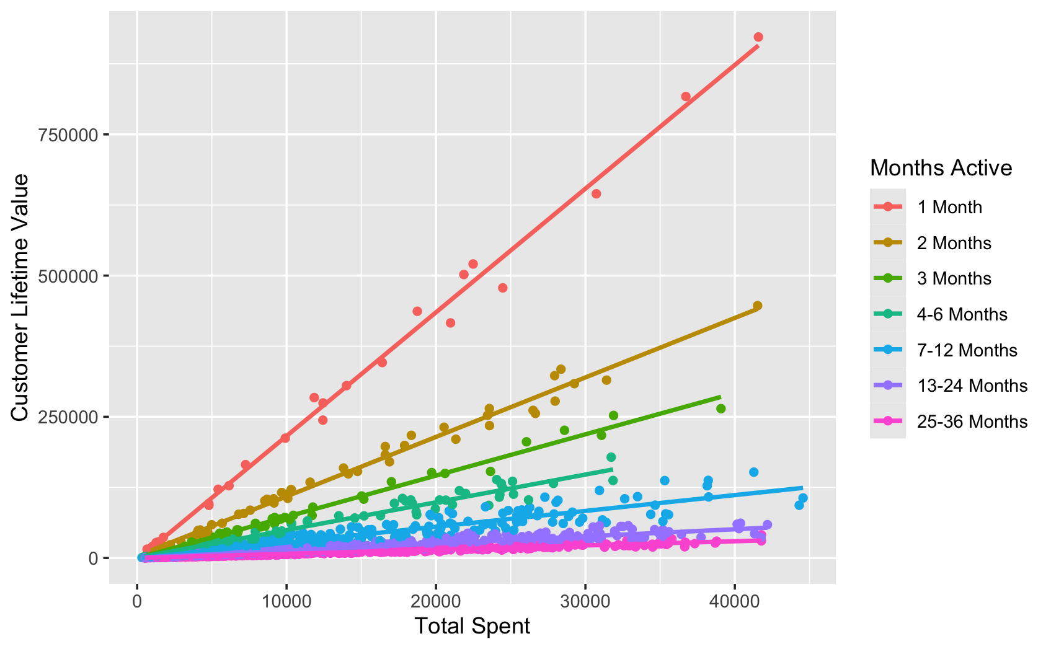
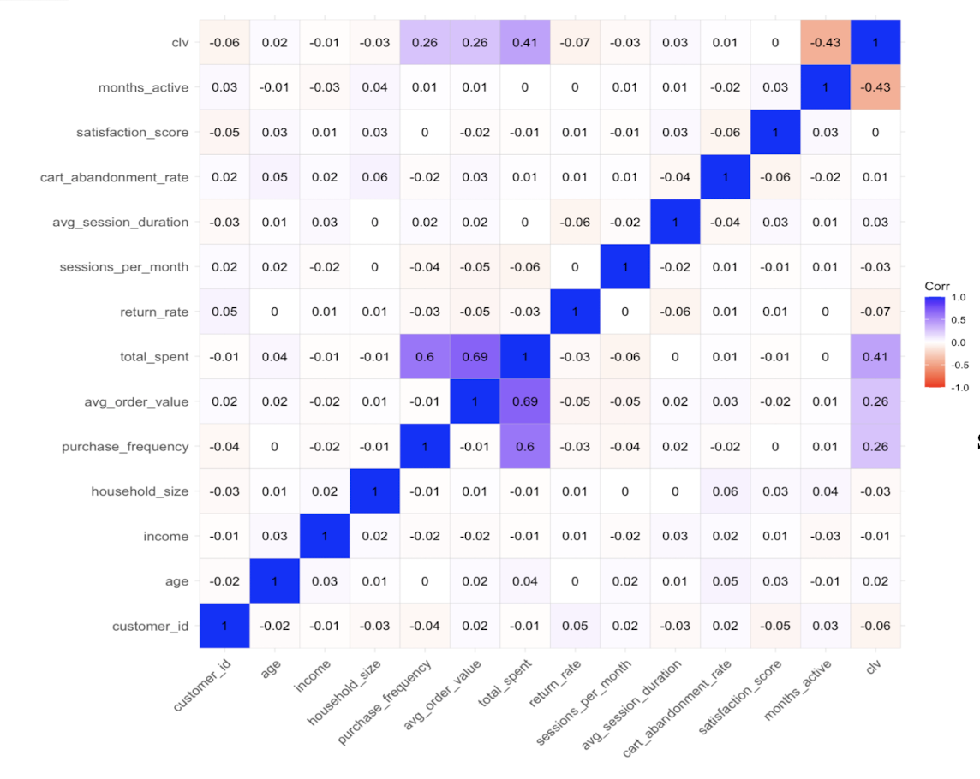
Customer Lifetime Value (CLV)
Notes:
Jad

Slide 18
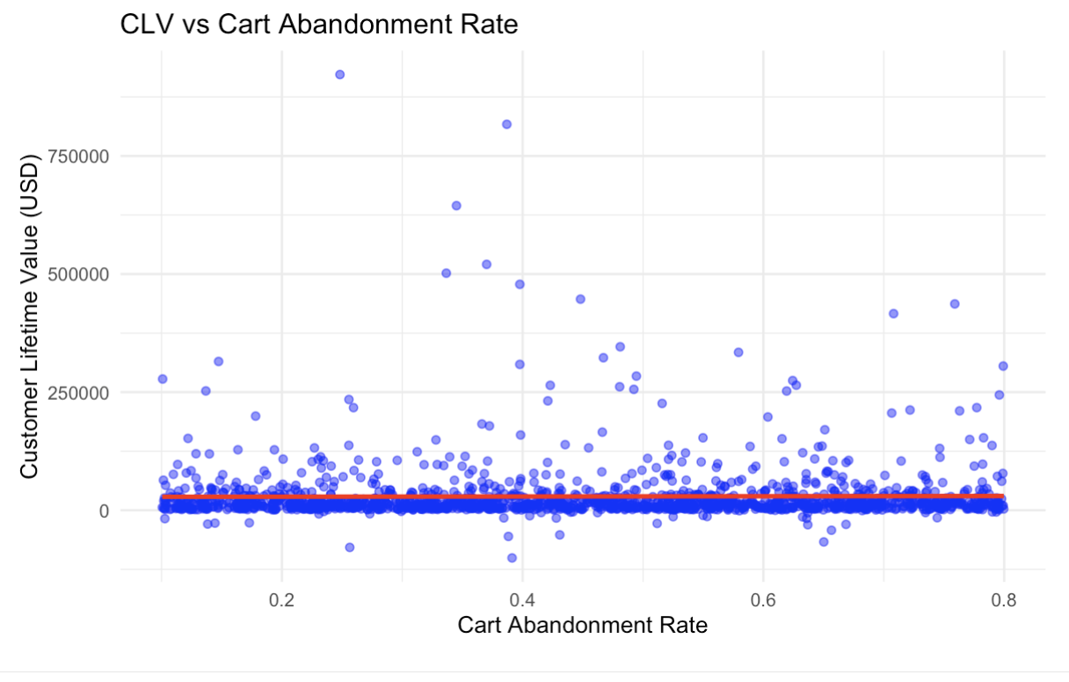
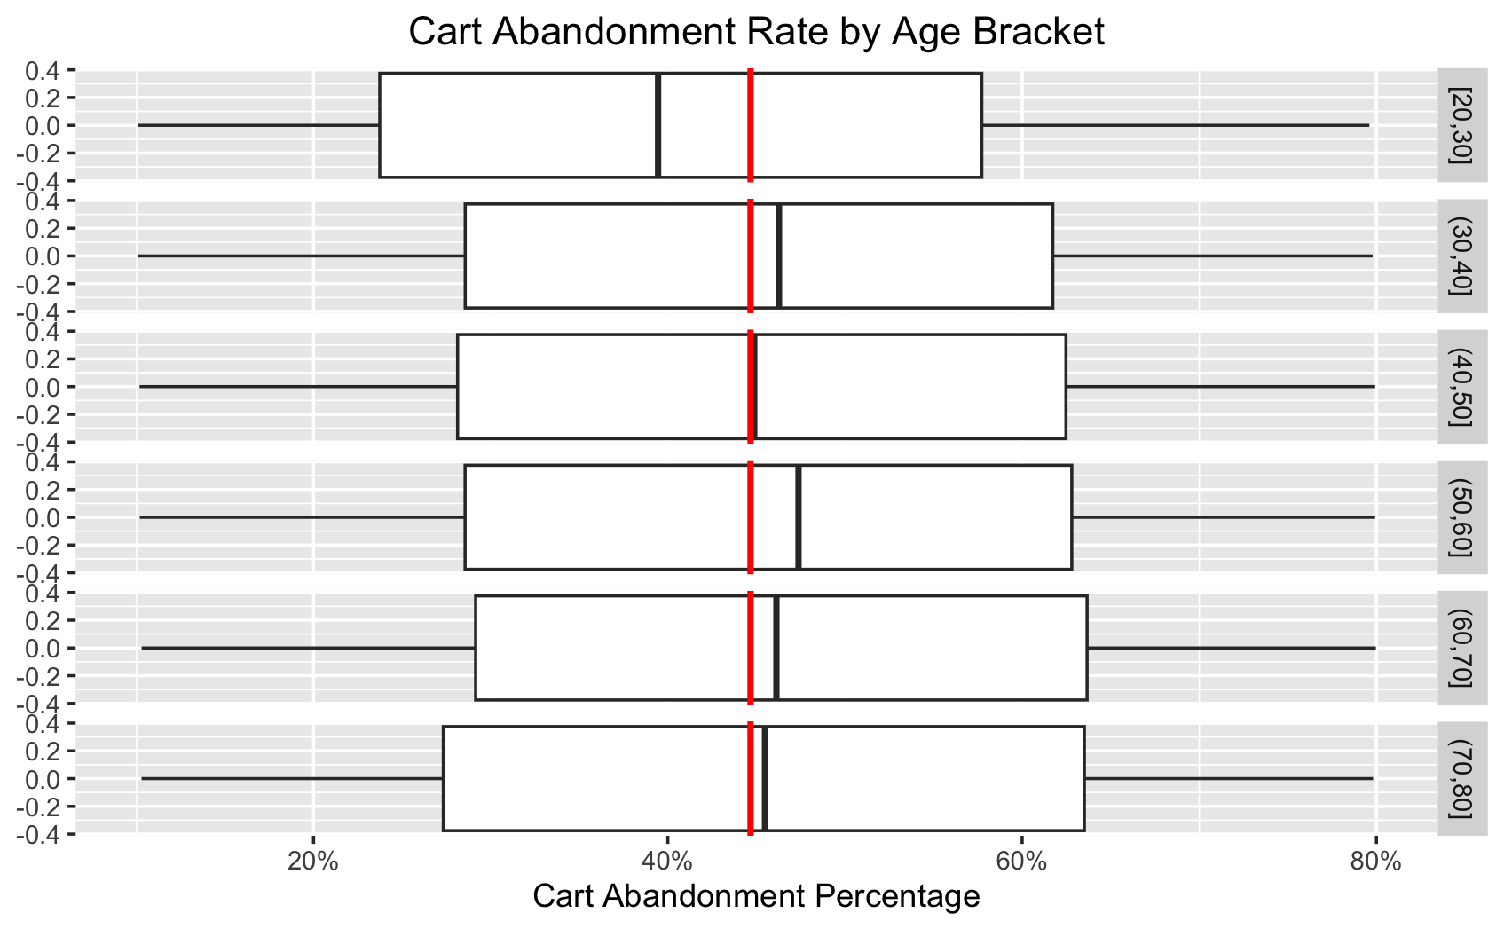
Cart Abandonment Rate
Notes:
Tenzin

Slide 19

Predictive
Modeling
Notes:
Luke

Slide 20
Predictive Modeling
Decision Tree
Identify Cart Abandonment Driving Factors
By training a decision tree, we can determine which customer behaviors (e.g., session duration, satisfaction score, homeowner status) most influence whether a user abandons their cart.
Make Data Decision Business Decisions
Users with higher average order values and longer session durations tend to have a lower probability of abandoning their carts.
Notes:
Luke

Slide 21

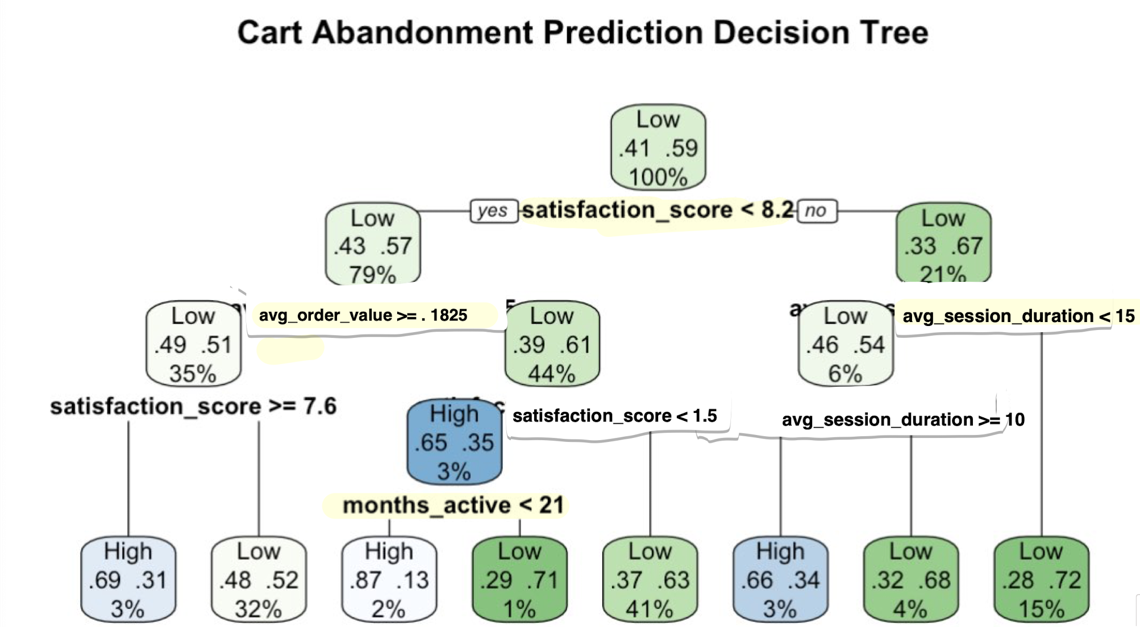
Prediction
Notes:
Luke

Slide 22
Predictive Modeling
Summary
Customer Satisfaction
Customers with lower satisfaction scores (< 8.2).
Shorter session durations (< 15 minutes) are more likely to abandon their carts.
Cart Abandonment Rate
High cart abandonment occurs when customers have low satisfaction scores (< 7.6), short browsing times, or low engagement.
Low cart abandonment is seen among longer active users (> 21 months) and those with higher satisfaction scores.
Strategies
Retention-focused strategies can target long-term customers with higher satisfaction to reduce abandonment rates.
Notes:
Luke

Slide 23
Roadblocks & Resolutions
Stat. Significance
Imputing NA Values
Finding EDA Trends
Correlation Analysis
Feature Engineering
Creating models to impute missing values
Many EDA illustrated relationships with very weak associations
Made forming suggestion more difficult
Homeowner Variable
Platform Compt.
Insufficient Data
Difficulty converting Categorical
Data into a Binary for the Decision Tree
Code must be cleaned to be compatible across all devices
Ensures reproducibility and cross-platform engagement
No data on marketing and customer acquisition costs even though it was one of the biggest challenge
Notes:
Luke

Slide 24

Strategic Recommendations
Notes:
Tenzin

Slide 25
Recommendation 1
Strategies to Attract & Convert High-Value Customers
Prioritize new customers
Launch a Referral Program
Reward existing customers for bringing in new buyers.
Offer discounts, store credits, or exclusive perks for successful referrals.
First-Purchase Discounts and Limited time bundles
Targeted follow-up campaigns
Don’t forget about your old customers
3+ months = $26.3M vs 0-3months = $17.5M
Loyalty program
Exceptional products and services helps build and maintain trust
Notes:
Tenzin

Slide 26
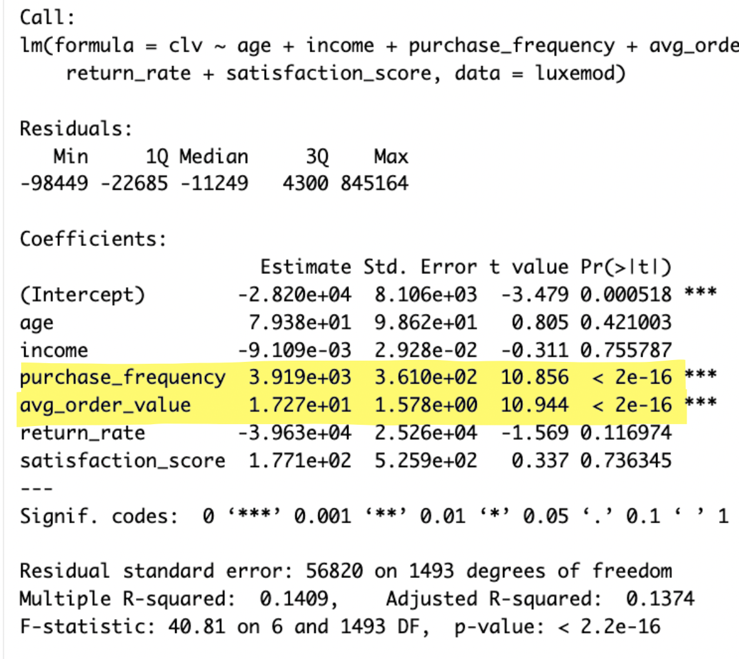
Recommendation 2
How to target customers and optimize marketing costs?
Don’t target demographics - though it may seem intuitive
Do target shopping behaviors
Purchase Frequency
~ $3,919 increase in CLV per additional purchase
Average Order Value (AOV)
$17 increase in CLV per $1 spent per order
Conclusion:
Focus on repeat purchases and higher order values.
Implement loyalty programs & bundling strategies to encourage larger transactions
Notes:
Tenzin

Slide 27
Next Steps
Gather additional data to refine customer acquisition cost (CAC) estimates and marketing spend tracking.
Analyze and optimize marketing budget allocation by identifying high-ROI customer segments and reducing spend on low-value audiences.
Improve tracking of acquisition sources to determine which marketing channels drive the highest CLV.
Refine retention strategies based on CLV insights, focusing on repeat purchases and loyalty incentives for top customers.
Notes:
Kalsang

Slide 28
Thank You!
Any Questions?
Notes:
Kalsang

